Slide 1
Many to many
Many to many

Slide 2
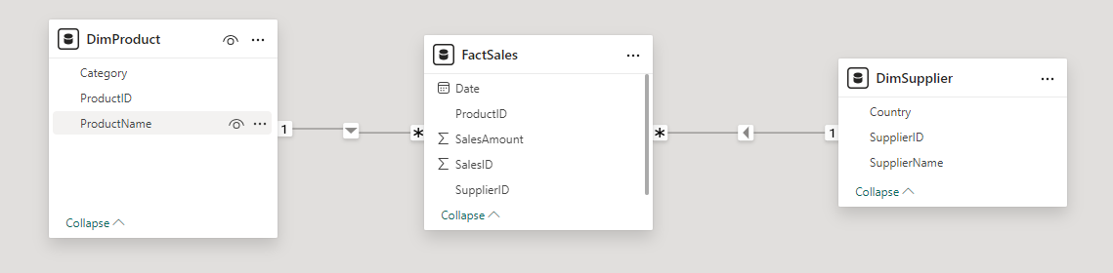
Many to many
Note: This lab uses the lab4.xlsx file in the Sales template
Create the relationships between the tables :
FactSales → DimProduct (via ProductID ).
FactSales → DimSupplier (via SupplierID ).

Slide 3
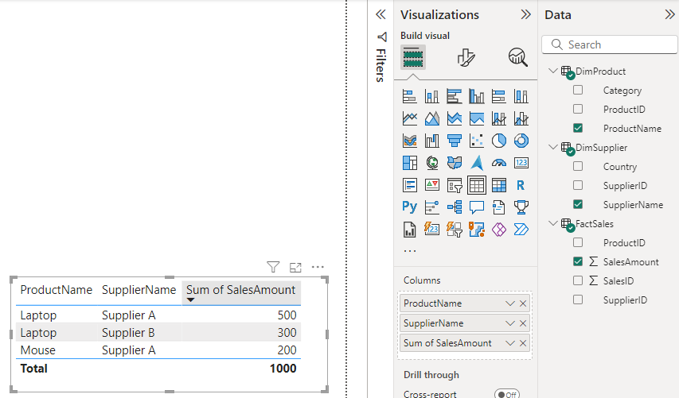
Many to many
Issue :
Products without sales (e.g. new products) and suppliers supplying products not yet sold are not represented .
Represent data with a Tableau visual
Note the missing information:
No data for Monitor (Product 103) or Keyboard (Product 104) .
Supplier C does not appear because he has no sales .

Slide 4
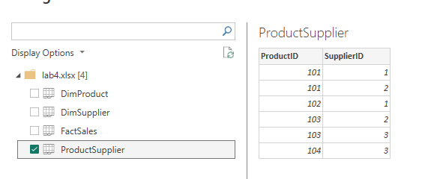
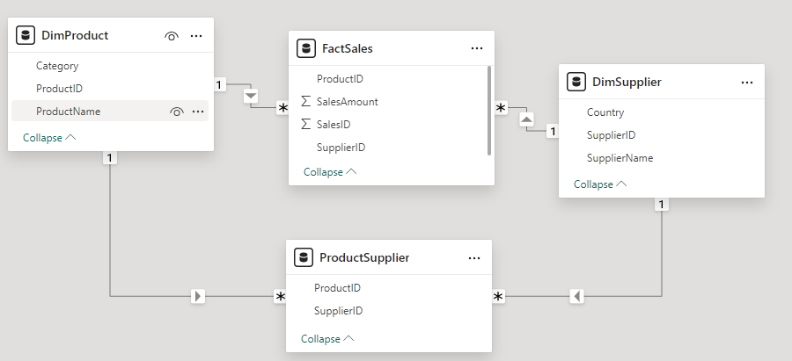
Many to many
Now add the ProductSupplier table .

Slide 5
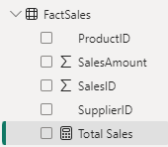
Many to many
Add a new measure to the FactSales table
Total Sales = SUMX ( ProductSupplier , COALESCE ( CALCULATE ( SUM ( FactSales[ SalesAmount ] )), 0 ))

Slide 6
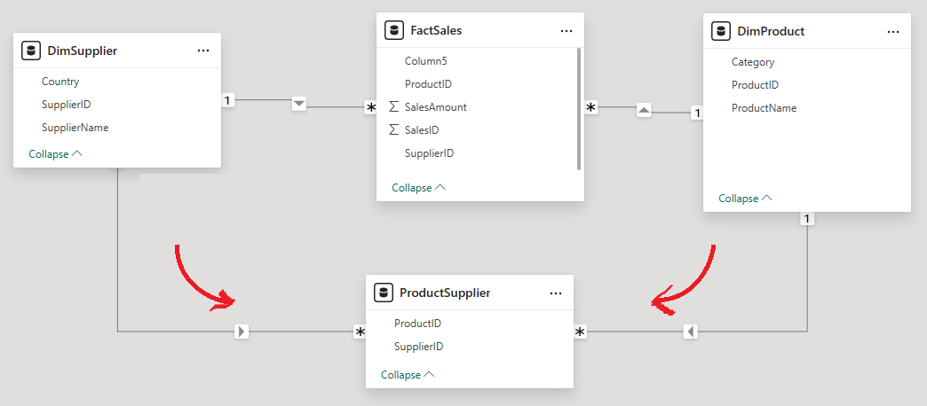
Many to many
The Total Sales metric calculates the sum of SalesAmount by traversing the ProductSupplier table

Slide 7
Many to many
Decomposition of the formula:
SUMX( ProductSupplier , …)
SUMX iterates through each row of the ProductSupplier table .
For each provider, it evaluates the expression provided as the second argument.
CALCULATE(SUM(FactSales[ SalesAmount ]))
SUM(FactSales[ SalesAmount ]) calculates the total sales.
CALCULATE applies the filter context to ensure that only related sales
to the supplier current are taken into account.
COALESCE(..., 0)
If a supplier has no sales in FactSales , SUM(FactSales[ SalesAmount ]) will return BLANK().
COALESCE replaces BLANK() with 0, thus avoiding empty values in the results.

Slide 8
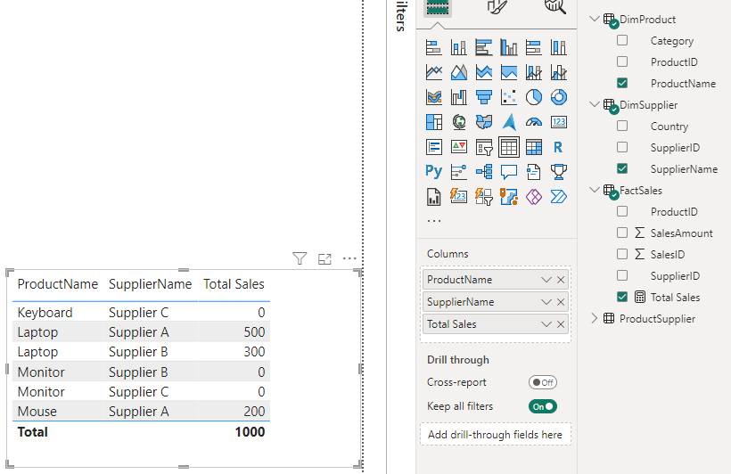
Many to many
Add a Table visual with ProductName , SupplierName and Total Sales as columns

Slide 9
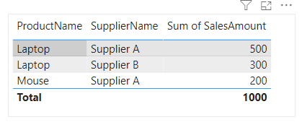
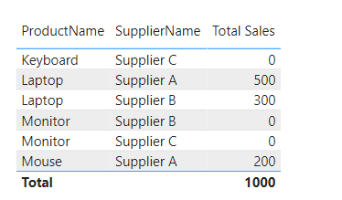
Many to many
Observe the difference now
Without Many to Many
With Many to Many

Slide 10
THANKS
THANKS

